Slide 1
Final Project Report
Data Science - Bank Marketing Campaign
Data Glacier - Team Datalux
Asmaa Alqurashi
Deepak Rawat
Huu Thien Nguyen

Slide 2

PROJECT SECTION
Group Information
Problem Description
GitHub Repository
Methods
Results
Discussion

Slide 3
Team Introduction
Group Name: Datalux
Group Members: 3
Specialisation: Data Science
Submitted to: Data Glacier canvas platform
Internship Batch: LISUM09
Name | Email | Country | Uni/Company
Huu Thien Nguyen | nguyenhuuthien27296@gmail.com | Sweden | Skövde University
Asmaa Alqurashi | asmaa.idk@gmail.com | Saudi Arabia | Taif University
Deepak Rawat | deepakrawat68@gmail.com | Ireland | Dublin Business School

Slide 4
Problem Description
The ABC Bank wants to market its term deposit product to clients in this project.
A machine learning model that will assist them in determining whether a particular consumer would buy their product.
Goal: Save the time and resources and finally leads to optimised cost for this campaign.

Slide 5

GitHub repository
The link for GitHub: https://github.com/AndrewNguyen27296/DataGlacier

Slide 6
Methods
A list of white-box ML models (logistic regression, a simple decision tree, and a Naive Bayes algorithm) and black-box ML models (ridge classifier, SVC, k neighbours classifier, gradient boosting, random forest, and neural network) was implemented to compare which model performs the best on this particular dataset.
Multiple classification metrics were utilised to examine the model. It included accuracy, recall, and ROC-AUC. F1 scores were also included.
Since the data has an imbalance output, the technique of under-sampling was implemented to provide a robust classification model.

Slide 7
Methods
One of the methods was splitting the data to train-valid-test to evaluate the chosen models and prevent data lake by training the model and evaluate it using the training and validating sets.
Cross validation was used to evaluating the model, or hyperparameter, the model has to be trained from scratch, each time, without reusing the training result from previous attempts. The result of the cross validation give us the optimized model.

Slide 8
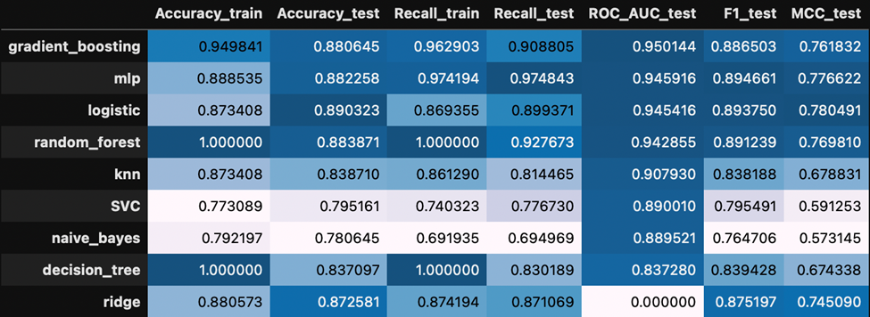
Results
The detailed metrics of white-box and black-box models are shown in the table below, in which the AUC_test is sorted in decreasing order. The black box functioned similarly to the white box in this case. However, it has a critical flaw: the core algorithm is incomprehensible. The inputs were undersampled to balance out the dependent variable.

Slide 9
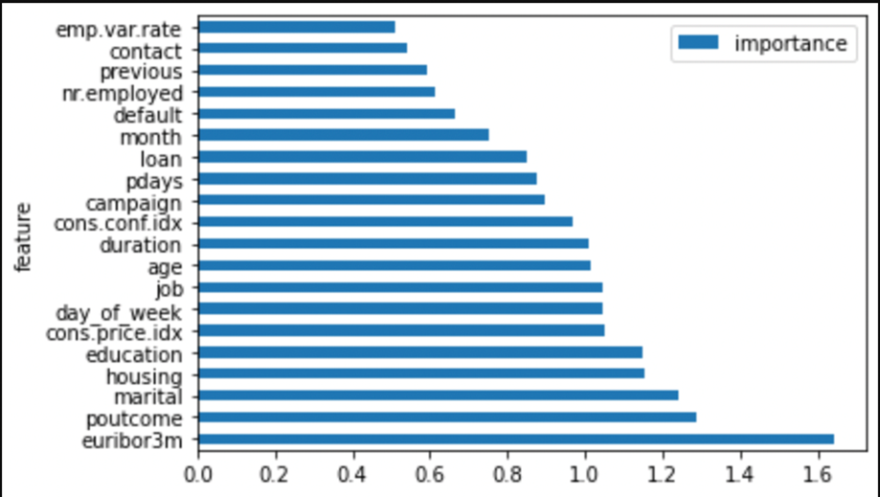
Results
In order to evaluate the influence of each feature on the classification model. The bar chart below was created to depict the feature important. The euribor3m, poutcome, and marital showed a highly effective score. The model was evaluated with all independent features without pre-processing. Therefore, with the appropriate feature engineering by using domain knowledge, a more powerful classification can be made for this project.

Slide 10
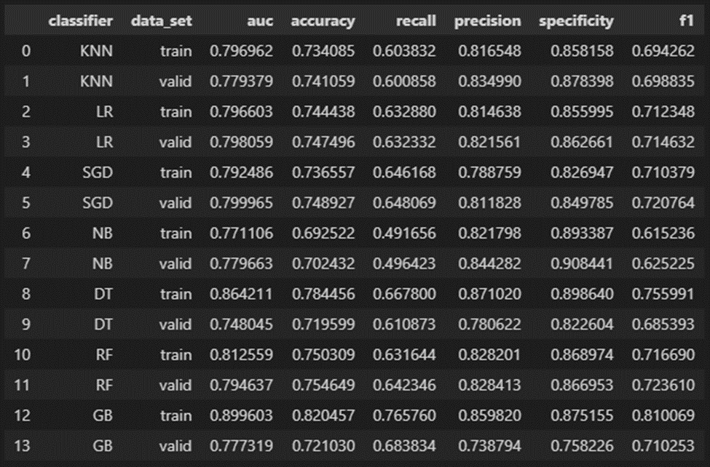
Results
Excluding the “Duration” feature from the model
The features were engineered and the “Duration” were excluded and the data was split to 70% train, 15% validation, and 15% test.
First of all, the comparison of the models’ scores in the train and valid sets are represented in the following table:

Slide 11
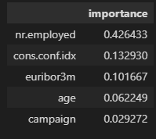
Results
Picking AUC performance indicator over other indicators since it is widely used and an easier metric to compare many models with.
All the algorithms have similar training AUC, but the ones that stood out are decision tree (DT) and gradient boosting (GB). Gradient boosting is considered the best metric to use because it has a higher AUC (0.89) than the other algorithms. At a threshold of 0.5, an AUC of 0.89 is good as it signifies that it is more than just a random guess towards a positive class.
After choosing the high score model let’s specify the features' importance in GB. The following table shows the top 5 most important features in the model.

Slide 12
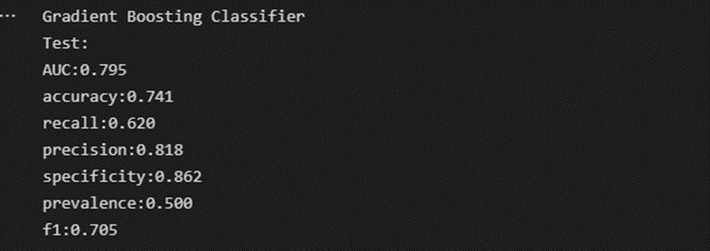
Results
As we choose Gradient Boosting Classifier as the best scoring model, we use cross validation to optimize the results.
Using RandomizedSearchCV we define the parameters and create an object to build the classifier with optimized hyperparameters
Finally we use the optimized model to evaluate it in the test set. Here is the results:

Slide 13
Discussion
Overall, this is an excellent project to help understand the whole cycle of a data science project, from collecting the data, preprocessing, modelling, and evaluating results.
Despite the project's progress in implementing interpretation methods, it faced several challenges.
As mentioned in the data exploration step, domain knowledge of banking is required because the data contain several features that need to be fully understood to make a feature engineering.
If a more experienced analyst analysed the outcome, some interesting insights could be obtained to aid the business decision. For instance, deploying marketing campaign on primary client segment (subscribed term deposit customers), which are married/single, non-existent poutcome, and do not have loans.
Aloso, Excluding the “duration” feature had a big impact on the model score but the model can be improved to give a better result without the feature by training it in more data and focusing on the most important features.

